Slide 1


30-Day Decompensation – Model v1
OCC Clinical Analytics
Randolph Schilke, MPH
Dr. Mikhail Kuprian, MD
October 19, 2023

Slide 2
Agenda
Objective
Population
Feature Selection
Model Development
Model Performance
Operations
Appendix

Slide 3



Objective
v1
v2
prospective timeline
Business Objective:
Determine, among adult veterans who utilize VA inpatient services, who are most likely to be readmitted within 30 days post discharge.
(v1) This will then be used to determine who should be targeted for inclusion in Patient Generated Health Data (PGHD) workstreams.
(v2) Refined model to include PGHD for targeted telehealth intervention/engagement.
Model Objective:
Utilizing a variety of data sources such as Corporate Data Warehouse (CDW) and Social Determinants of Health data predict which discharged veterans are most likely be readmitted to an inpatient setting.

Slide 4
Population
Inclusion
Inpatient admissions between January 1, 2022 – December 31, 2022
Admission Type
  DIRECT
  OPT-SC
  TO ASIH
  NON-SERVICE CONNECTED (OPT-NSC)
  AMBULATORY CARE (OPT-AC)
Discharge Type
  NON-SERVICE CONNECTED (OPT-NSC)
  OPT-SC
  REGULAR
  IRREGULAR
Ward Admit Specialties (Top 10, see Appendix A)
  GENERAL(ACUTE MEDICINE)
  GERNERAL SURGERY
  MEDICAL ICU
  TELEMETRY
  SURGICAL ICU
  MEDICAL STEP DOWN
  GEN MEDICINE (ACUTE)
  SURGINCAL STEPDOWN
  SPINAL CORD INJURY
  PULMONARY, NON-TB
Active Sta3n Only
Admit & Discharge Date Time is not Null

Slide 5
Population (continued)
Exclusion
Ward Admit Medical Service (Not Like)
  ‘%NHCU%’
  ‘%NH SHORT%’
  ‘%NH LONG%’
  ‘%DOMICILIARY%’
  ‘%PSYCH%’
  ‘%REHAB%’
  ‘%SURGICAL OBSERVATION%’
Null ICN
Test Patients
Discharged patients with readmit within 2-days
Death within 30-days

Slide 6
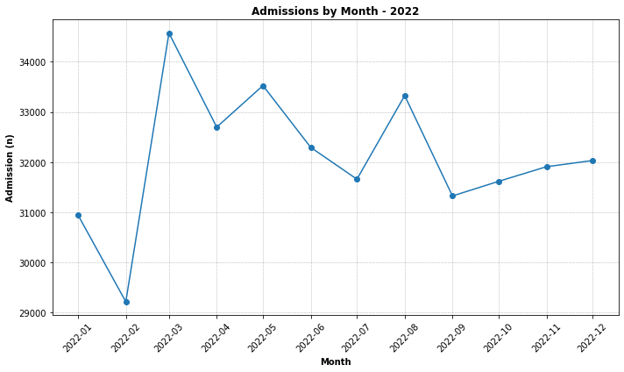
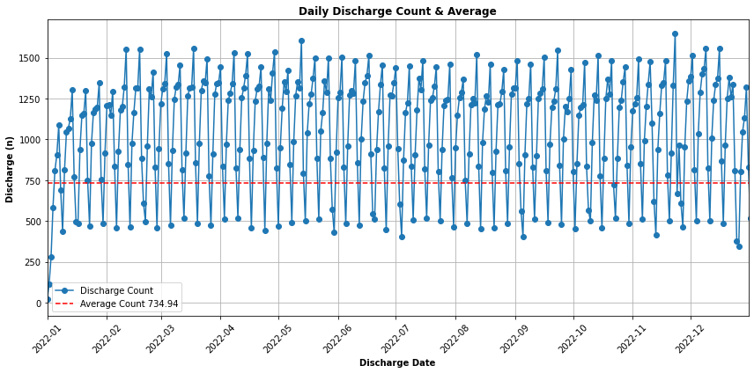
Population (continued)

Slide 7
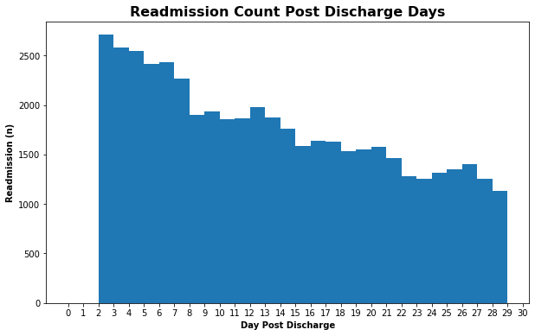
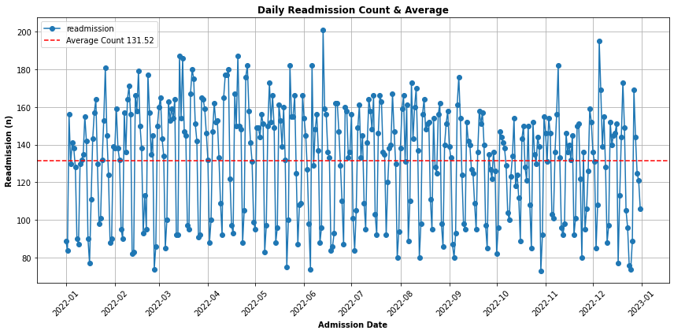
Dependent Variable
Readmission is used as a proxy for decompensation in patients because it indicates that the patient’s medical condition has deteriorated.
Inpatient admit datetimes that are between 2-30 days after a prior inpatient discharge date time.
Readmissions that occurred within 2-30 days and were “Scheduled Admissions” were not considered.
2-days was selected because, there is a one-day data lag for CDW, additionally another one-day was warranted to make predictions on patients that could be actionable by the business.

Slide 8
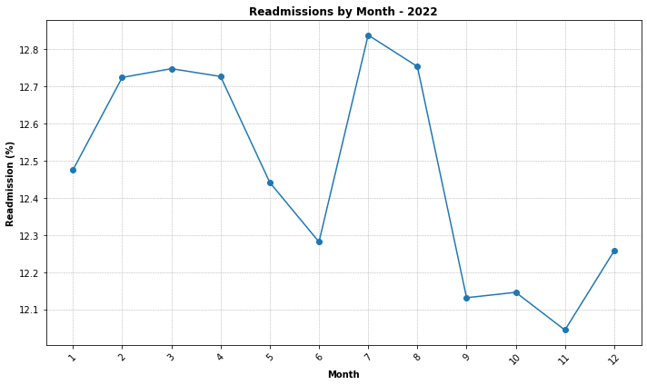
Dependent Variable (continued)

Slide 9

Data Split
[n = 385,107] [Readmission = 48,005] 12.47%
Train (80%)
Pre-Up Sample
[n =308,085 ]
[Readmission = 38,239] 12.41%
Feature Selection
Train (56%)
Validation (24%)
Test (20%)
Modeling
[n =77,022 ]
[Readmission = 9,766] 12.76%

Slide 10
Feature Selection
Demographics
Family Details
Health Factor
Type
Gender
Medical History
Charlson Comorbidity Index
RX
Utilization
Prior Readmission 12m
Age
Race
Social Determinants of Health
Geographic information
Drug Name During Inpatient
Religion
Insurance Coverage
Chronic conditions 1yr, 2yr
Admission/Discharge ICD10
First Time Dx
Ward Admit/Discharge Specialty
Prior Readmission 12m Count
No Show Appointment
Inpatient/Output Utilization 1 yr
Appointment Made During Inpatient Visit
2,454 Features investigated
655 Features considered
452 Features selected
Removed Features having incomplete data >20%
Removed Features where there is low variation.
Removed variables with multicollinearity (correlation threshold >0.7)
Univariate logistic regression, lasso regression, gradient boosting machines, and random forest applied to identify most important variables
* For a full list of features refer to occ_clinical_analytics_decompensation github repository

Slide 11
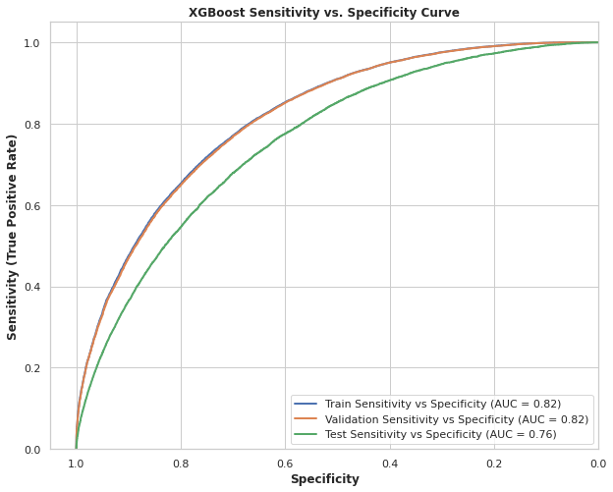
Modeling
Exploration:
Auto ML
Logistic Regression
Vanilla
Regularization
Random Forest
GBM
XGBoost
AUC Inference:
A randomly selected member episode from the group with target equals one has a score larger than for a randomly chosen member episode from the group with the target equals zero in 76% of the time.

Slide 12
Model Performance
Patients among the 1st twentile have higher likelihood of 30-day readmission than patients in subsequent twentiles. E.g. 44.5% of patients among the first twentile will be readmitted within 30-days post discharge
High
Medium
Low
Patients in the 1st twentile are 3.49x more likely than average to be readmitted within 30-days post discharge
Patients in the 8th – 20th twenties have a lower likelihood than average of being readmitted within 30-days post discharge
Test reference= 12.76%
High Probability
Low Probability
* Performance for top 79 of Sta3n’s that account for 94% of all inpatient discharges. See Appendix C for excluded Sta3n’s.

Slide 13
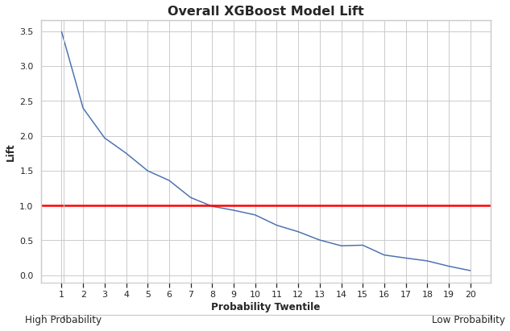
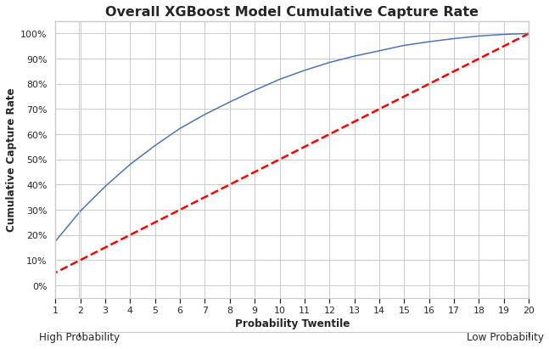
Model Performance (continued)
By targeting lower twentiles, higher probabilities, we can see we expect to capture more readmission’s than without a model. For example, by targeting the 1st twentile alone we expect to capture nearly 20% of all readmissions.
Patients in the lower twentiles, higher probability, 1-8 are more actionable than lower twentiles and should be targeted first.
* Performance for top 79 of Sta3n’s that account for 94% of all inpatient discharges. See Appendix C for excluded Sta3n’s.

Slide 14
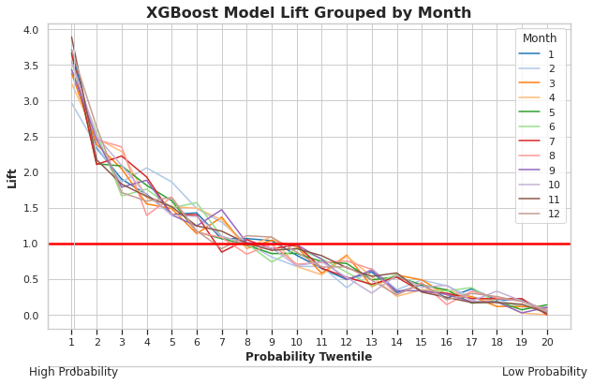
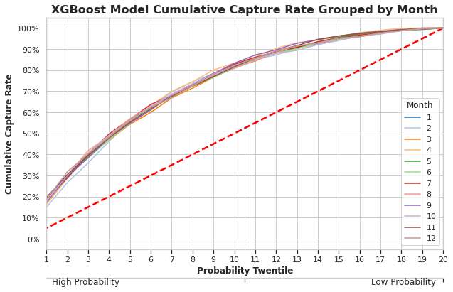
Model Performance (continued)
Regardless of time, we expect consistent and equitable model performance prospectively
* Performance for top 79 of Sta3n’s that account for 94% of all inpatient discharges. See Appendix C for excluded Sta3n’s.

Slide 15
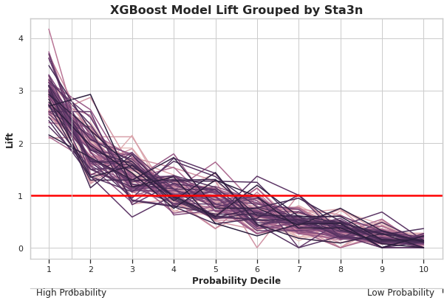
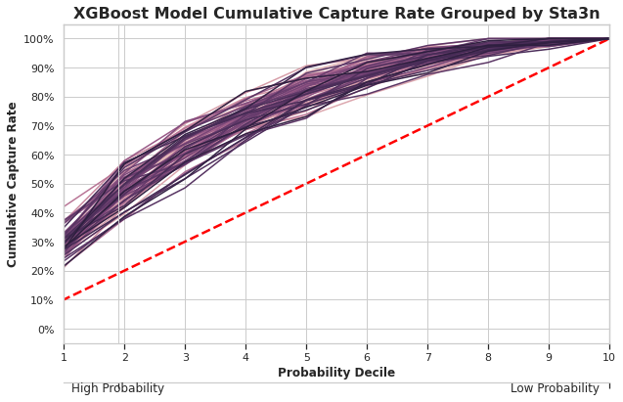
Model Performance (continued)
Regardless of Sta3n, we expect consistent and equitable model performance across the USA
* Performance for top 79 of Sta3n’s that account for 94% of all inpatient discharges. See Appendix C for excluded Sta3n’s.

Slide 16
Model Performance (continued)
30-Day Decompensation – Model v1 exhibits consistent fairness and equity regardless of time and location of hospital.
30-Day Decompensation – Model v1 is estimated to achieve 3.49x readmission identification in comparison to random targeting
The business should productionize the 30-Day Decompensation – Model v1 if their goal is to identify more at-risk readmission patients and onboard them to PGHD data collection.

Slide 17





Operations
Patient Journey Prospective Timeline
Inpatient
CDW 1-Day Behind
Outreach/Engagement

Slide 18
Appendix

Slide 19
Appendix A: Ward Admit Specialties
 | Count | Count | Row% | Row% | Total Count
Readmission | 0 | 1 | 0 | 1
Ward Admit Specialty
GENERAL(ACUTE MEDICINE) | 155,391 | 25,225 | 86.03 | 13.97 | 180,616
MEDICAL OBSERVATION | 56,920 | 6,019 | 90.44 | 9.56 | 62,939
GENERAL SURGERY | 45,764 | 4,652 | 90.77 | 9.23 | 50,416
MEDICAL ICU | 22,302 | 3,763 | 85.56 | 14.44 | 26,065
SURGICAL ICU | 12,252 | 1,488 | 89.17 | 10.83 | 13,740
TELEMETRY | 11,714 | 1,962 | 85.65 | 14.35 | 13,676
MEDICAL STEP DOWN | 8,855 | 1,350 | 86.77 | 13.23 | 10,205
GEN MEDICINE (ACUTE) | 4,084 | 750 | 84.48 | 15.52 | 4,834
SURGICAL STEPDOWN | 3,921 | 560 | 87.50 | 12.50 | 4,481
SPINAL CORD INJURY | 2,837 | 286 | 90.84 | 9.16 | 3,123
CARDIAC-STEP DOWN UNIT | 1,876 | 267 | 87.54 | 12.46 | 2,143
PULMONARY, NON-TB | 1,753 | 309 | 85.01 | 14.99 | 2,062
NEUROLOGY | 1,837 | 166 | 91.71 | 8.29 | 2,003
HEMATOLOGY/ONCOLOGY | 1,514 | 415 | 78.49 | 21.51 | 1,929
METABOLIC | 1,451 | 228 | 86.42 | 13.58 | 1,679
THORACIC SURGERY | 1,074 | 142 | 88.32 | 11.68 | 1,216
CARDIAC INTENSIVE CARE UNIT | 1,018 | 189 | 84.34 | 15.66 | 1,207
 | Count | Count | Row% | Row% | Total Count
Readmission | 0 | 1 | 0 | 1
Ward Admit Specialty
VASCULAR | 473 | 36 | 92.93 | 7.07 | 509
ORTHOPEDIC | 482 | 14 | 97.18 | 2.82 | 496
CARDIOLOGY | 351 | 67 | 83.97 | 16.03 | 418
UROLOGY | 296 | 35 | 89.43 | 10.57 | 331
NEUROLOGY OBSERVATION | 307 | 20 | 93.88 | 6.12 | 327
INTERMEDIATE MEDICINE | 242 | 33 | 88.00 | 12.00 | 275
NEUROSURGERY | 179 | 10 | 94.71 | 5.29 | 189
EAR, NOSE, THROAT (ENT) | 97 | 8 | 92.38 | 7.62 | 105
CARDIAC SURGERY | 30 | 2 | 93.75 | 6.25 | 32
TRANSPLANTATION | 23 | 7 | 76.67 | 23.33 | 30
EPILEPSY CENTER | 25 | 0 | 100.00 | 0.00 | 25
SPINAL CORD INJURY OBSERVATION | 18 | 0 | 100.00 | 0.00 | 18
SPINAL CORD INJURY LTC CENTER | 11 | 1 | 91.67 | 8.33 | 12
PLASTIC SURGERY | 4 | 1 | 80.00 | 20.00 | 5
GEM INTERMEDIATE CARE | 1 | 0 | 100.00 | 0.00 | 1

Slide 20
Appendix B: Sta3n Descriptives

Slide 21
Appendix B: Sta3n Descriptives (continued)

Slide 22
Appendix B: Sta3n Descriptives (continued)

Slide 23
Appendix B: Sta3n Descriptives (continued)

Slide 24
Appendix B: Sta3n Descriptives (continued)

Slide 25
Appendix C: Sta3n Model Exclusion
109 Sta3ns were included in model.
30 Sta3n were removed from model performance due to low counts on test.
(586) Jackson, MS
(402) Togus ME
(613) Martinsburg, WV
(632) Northport, NY
(460) Wilmington DE
(590) Hampton, VA
(405) White River Junction VT
(564) Fayetteville, AR
(504) Amarillo HCS (Amarillo TX)
(437) Fargo, ND (CACHE 5.0)
(438) Sioux Falls SD (CACHE 5.0)
(619) Central Alabama HCS (Montgomery AL)
(568) Black Hills HCS (Fort Meade SD) (CACHE 5.0)
(540) Clarksburg, WV
(517) Beckley, WV
(649) Northern Arizona HCS (Prescott AZ)
(442) Cheyenne WY
(520) Biloxi, MS
(436) Montana HCS (Fort Harrison MT)
(610) Northern Indiana HCS (Marion, IN)
(503) Altoona, PA
(620) Hudson Valley HCS (Castle Point, Montrose)
(585) Iron Mountain, MI
(676) Tomah, WI
(550) Illiana HCS (Danville IL)
(502) Alexandria, LA
(575) Grand Junction, CO
(666) Sheridan, WY
(557) Dublin, GA
(562) Erie, PA
Top 79 Sta3n’s Account for 94% of all Discharges
& 96% of all readmissions

Slide 26
Questions?

